Slide 1
Medical Information Retrieval

Slide 2
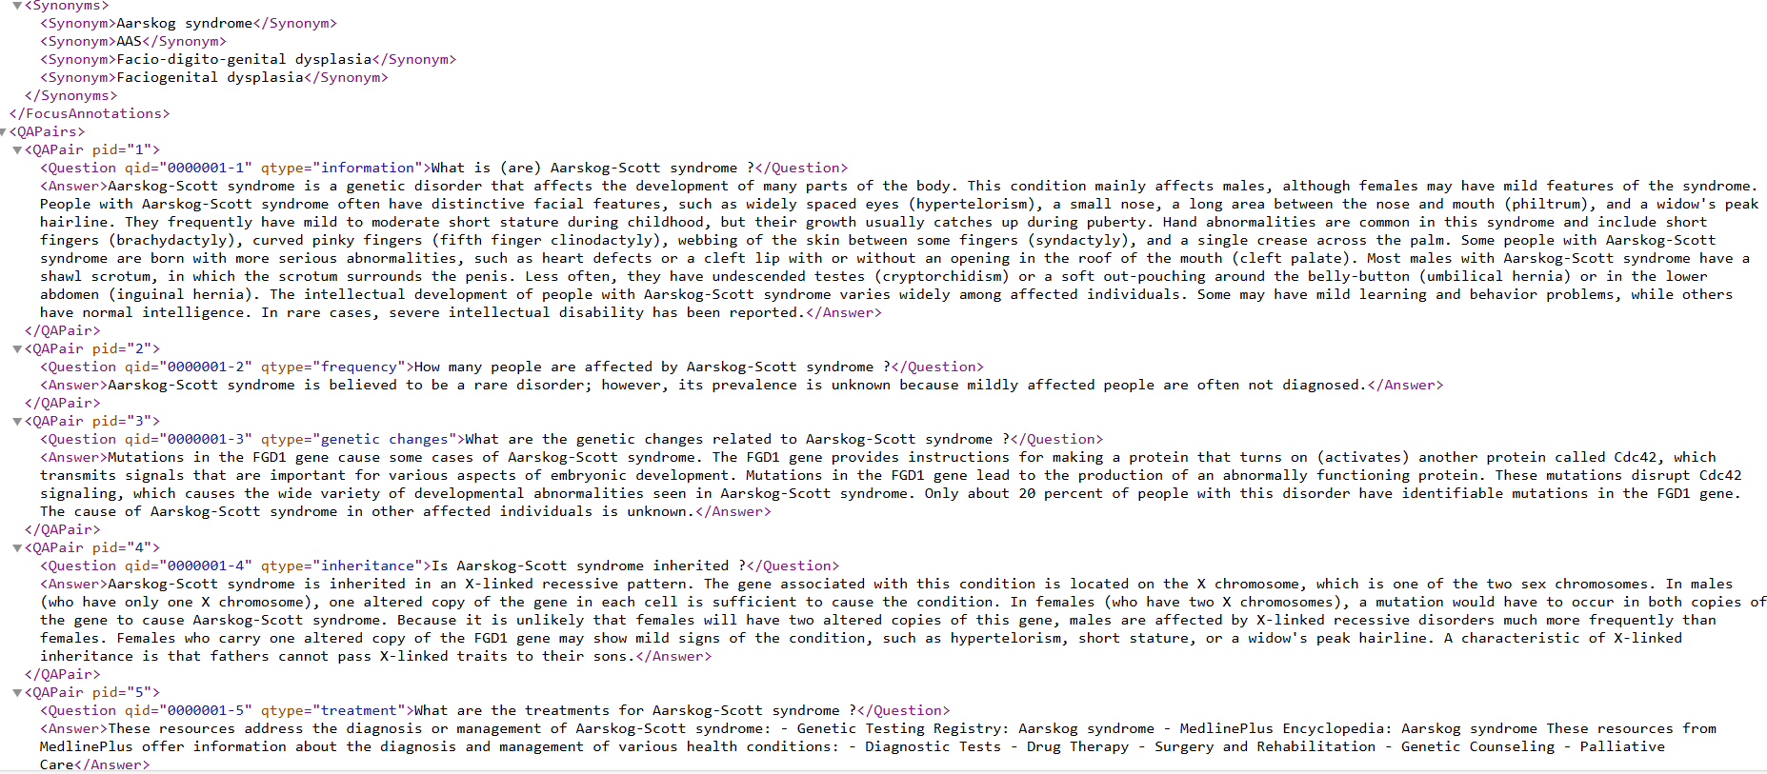
Datasets
Dataset consists of 1086 xml files which has 5 QA pairs on different topics in Health care(Diseases).
Sample of the dataset (one XML file) looks as follows:

Slide 3
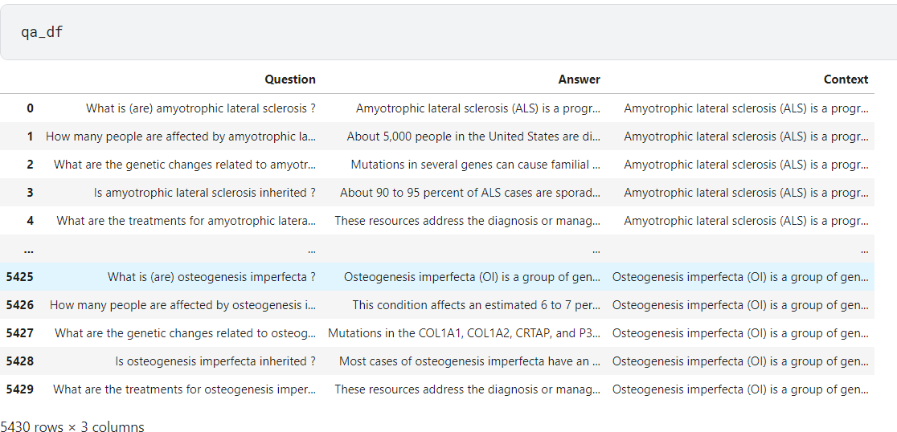
Data Pre-processing
Original dataset has only question and answers. No context is available in the MedQuAD dataset
Created context by concatenation of all the 5 answers related to one disease (one XML file) and used it for inference.

Slide 4
STS performance metrics (1 sentence answer)
Extracting most similar sentence with question from the context using Cosine Similarity.
Performance of BERT variants is as follows:
# | Model | EM | F1 | Precision | Recall
1 | sentence-transformers/paraphrase-distilroberta-base-v1 | 0.0254 | 0.1658 | 0.5681 | 0.1192
2 | emilyalsentzer/Bio_ClinicalBERT | 0.005 | 0.1397 | 0.5374 | 0.097
3 | dmis-lab/biobert-base-cased-v1.1 | 0.0182 | 0.1534 | 0.5601 | 0.1085
4 | bionlp/bluebert_pubmed_mimic_uncased_L-12_H-768_A-12 | 0.0182 | 0.1467 | 0.539 | 0.1049
5 | bert-base-uncased | 0.0254 | 0.1577 | 0.5598 | 0.1133
6 | roberta-base | 0.009 | 0.1367 | 0.5544 | 0.0943
7 | distilbert-base-uncased | 0.014 | 0.1484 | 0.5598 | 0.104

Slide 5
Embeddings
Different types of embeddings are used in the process.
1. Mean Pooling
Average of all the token embeddings of output layer
2. CLS Token
Embeddings from CLS token are used
3. Concatenation of last 3 layers
Concatenation of all the token embeddings of last 3 layers
4. Concatenation of last 4 layers
Concatenation of all the token embeddings of last 4 layers
5. Mean Pooling of last 3 layers
Average of all the token embeddings of last 3 layers

Slide 6
Adaptive Threshold Logic for Sentence Selection
Cosine similarity is used to compare the question embedding with each sentence embedding from the context.
Instead of using a fixed similarity threshold, an adaptive threshold is calculated based on the distribution of the similarity scores.
The threshold is set dynamically at the 60th percentile, meaning the top 40% of sentences with the highest similarity scores are considered for selection.
Sentences with a score above the adaptive threshold are selected, with a maximum limit on the number of sentences (3 sentences) to provide a concise, relevant answer.
If no sentences meet the threshold, the highest scoring sentence is selected as a fallback to ensure an answer is always provided.

Slide 7
STS performance metrics (Multi-Sentence Answers)
Performance of BERT variants using output embeddings considering answers span in multiple sentences is as follows:
# | Model | Embedding Type | EM | F1 | Precision | Recall
1 | sentence-transformers/paraphrase-distilroberta-base-v1 | Sentence Embeddings | 0 | 0.2172 | 0.3512 | 0.2237
2 | emilyalsentzer/Bio_ClinicalBERT | Mean Pooling | 0 | 0.1919 | 0.3313 | 0.1884
3 | emilyalsentzer/Bio_ClinicalBERT | CLS Token | 0 | 0.2199 | 0.3589 | 0.2285
4 | dmis-lab/biobert-base-cased-v1.1 | Mean Pooling | 0 | 0.2076 | 0.3483 | 0.2112
5 | dmis-lab/biobert-base-cased-v1.1 | CLS Token | 0 | 0.2575 | 0.406 | 0.2632
6 | bionlp/bluebert_pubmed_mimic_uncased_L-12_H-768_A-12 | Mean Pooling | 0 | 0.2071 | 0.3378 | 0.2131
7 | bionlp/bluebert_pubmed_mimic_uncased_L-12_H-768_A-12 | CLS Token | 0.0002 | 0.1881 | 0.3396 | 0.1832
8 | bert-base-uncased | Mean Pooling | 0 | 0.2174 | 0.3504 | 0.2284
9 | bert-base-uncased | CLS Token | 0.0004 | 0.2443 | 0.3595 | 0.261
10 | roberta-base | Mean Pooling | 0 | 0.189 | 0.3528 | 0.1809
11 | roberta-base | CLS Token | 0 | 0.1955 | 0.3637 | 0.1883
12 | distilbert-base-uncased | Mean Pooling | 0 | 0.2088 | 0.355 | 0.2099
13 | distilbert-base-uncased | CLS Token | 0.0002 | 0.2081 | 0.365 | 0.2024

Slide 8
STS performance metrics (Multi-Sentence Answers)
Performance of top models in Massive Text Embedding Benchmark using output embeddings considering answers span in multiple sentences is as follows:
# | Model | EM | F1 | Precision | Recall
1 | Lajavaness/bilingual-embedding-large | 0 | 0.26 | 0.45 | 0.25
2 | w601sxs/b1ade-embed | 0 | 0.28 | 0.49 | 0.26
3 | mixedbread-ai/mxbai-embed-large-v1 | 0 | 0.28 | 0.47 | 0.27
4 | Labib11/MUG-B-1.6 | 0 | 0.29 | 0.5 | 0.27
5 | mixedbread-ai/mxbai-embed-2d-large-v1 | 0 | 0.29 | 0.5 | 0.27

Slide 9
STS performance metrics (Multi-Sentence Answers)
Performance of BERT variants using concatenation of last 3-layer embeddings considering answers span in multiple sentences is as follows:
# | Model | Embedding Type | EM | F1 | Precision | Recall
1 | sentence-transformers/paraphrase-distilroberta... | Mean Pooling | 0 | 0.196462 | 0.348933 | 0.191629
2 | emilyalsentzer/Bio_ClinicalBERT | Mean Pooling | 0 | 0.185901 | 0.335664 | 0.177218
3 | emilyalsentzer/Bio_ClinicalBERT | CLS | 0 | 0.204033 | 0.353826 | 0.198797
4 | dmis-lab/biobert-base-cased-v1.1 | Mean Pooling | 0 | 0.198971 | 0.348527 | 0.195493
5 | dmis-lab/biobert-base-cased-v1.1 | CLS | 0 | 0.208218 | 0.358188 | 0.204064
6 | bionlp/bluebert_pubmed_mimic_uncased_L-12_H-76... | Mean Pooling | 0 | 0.196094 | 0.33969 | 0.193429
7 | bionlp/bluebert_pubmed_mimic_uncased_L-12_H-76... | CLS | 0 | 0.189914 | 0.331667 | 0.185624
8 | bert-base-uncased | Mean Pooling | 0 | 0.21645 | 0.350742 | 0.225853
9 | bert-base-uncased | CLS | 0.000552 | 0.211526 | 0.367107 | 0.21367
10 | roberta-base | Mean Pooling | 0 | 0.184724 | 0.35042 | 0.174745
11 | roberta-base | CLS | 0 | 0.207318 | 0.35039 | 0.203608
12 | distilbert-base-uncased | Mean Pooling | 0 | 0.195889 | 0.345988 | 0.190271
13 | distilbert-base-uncased | CLS | 0 | 0.191566 | 0.347302 | 0.185051

Slide 10
STS performance metrics (Multi-Sentence Answers)
Performance of BERT variants using mean pooling of last 3-layer embeddings considering answers span in multiple sentences is as follows:
# | Model | Pooling Method | EM | F1 | Precision | Recall
1 | sentence-transformers/paraphrase-distilroberta... | Mean Pooling | 0 | 0.20 | 0.35 | 0.20
2 | emilyalsentzer/Bio_ClinicalBERT | Mean Pooling | 0 | 0.19 | 0.34 | 0.18
3 | emilyalsentzer/Bio_ClinicalBERT | CLS | 0 | 0.21 | 0.36 | 0.20
4 | dmis-lab/biobert-base-cased-v1.1 | Mean Pooling | 0 | 0.20 | 0.35 | 0.20
5 | dmis-lab/biobert-base-cased-v1.1 | CLS | 0 | 0.21 | 0.36 | 0.21
6 | bionlp/bluebert_pubmed_mimic_uncased_L-12_H-76... | Mean Pooling | 0 | 0.20 | 0.34 | 0.20
7 | bionlp/bluebert_pubmed_mimic_uncased_L-12_H-76... | CLS | 0 | 0.19 | 0.33 | 0.19
8 | bert-base-uncased | Mean Pooling | 0 | 0.22 | 0.35 | 0.23
9 | bert-base-uncased | CLS | 0 | 0.21 | 0.37 | 0.22
10 | roberta-base | Mean Pooling | 0 | 0.18 | 0.35 | 0.17
11 | roberta-base | CLS | 0 | 0.21 | 0.34 | 0.21
12 | distilbert-base-uncased | Mean Pooling | 0 | 0.20 | 0.34 | 0.19
13 | distilbert-base-uncased | CLS | 0 | 0.19 | 0.35 | 0.19

Slide 11
STS performance metrics (Multi-Sentence Answers)
Performance of BERT variants using mean pooling of last 4-layer embeddings considering answers span in multiple sentences is as follows:
# | Model | Pooling Method | EM | F1 | Precision | Recall
1 | sentence-transformers/paraphrase-distilroberta... | Mean Pooling | 0 | 0.20 | 0.35 | 0.19
2 | emilyalsentzer/Bio_ClinicalBERT | Mean Pooling | 0 | 0.19 | 0.34 | 0.18
3 | emilyalsentzer/Bio_ClinicalBERT | CLS | 0 | 0.19 | 0.34 | 0.18
4 | dmis-lab/biobert-base-cased-v1.1 | Mean Pooling | 0 | 0.20 | 0.35 | 0.19
5 | dmis-lab/biobert-base-cased-v1.1 | CLS | 0 | 0.20 | 0.35 | 0.20
6 | bionlp/bluebert_pubmed_mimic_uncased_L-12_H-76... | Mean Pooling | 0 | 0.20 | 0.34 | 0.19
7 | bionlp/bluebert_pubmed_mimic_uncased_L-12_H-76... | CLS | 0 | 0.19 | 0.33 | 0.19
8 | bert-base-uncased | Mean Pooling | 0 | 0.21 | 0.35 | 0.22
9 | bert-base-uncased | CLS | 0 | 0.20 | 0.35 | 0.19
10 | roberta-base | Mean Pooling | 0 | 0.18 | 0.35 | 0.17
11 | roberta-base | CLS | 0 | 0.20 | 0.35 | 0.20
12 | distilbert-base-uncased | Mean Pooling | 0 | 0.19 | 0.34 | 0.19
13 | distilbert-base-uncased | CLS | 0 | 0.19 | 0.34 | 0.19

Slide 12
QA performance metrics
Performance with Question Answering Pipeline from transformers module using BERT variants and other QA models is as follows:
# | Model | EM | F1 | Precision | Recall
1 | BERT | 0 | 0.116986 | 0.7724 | 0.067325
2 | ALBERT | 0.00221 | 0.149343 | 0.769693 | 0.091613
3 | RoBERTa | 0.001105 | 0.116617 | 0.74049 | 0.068719
4 | DistilBERT | 0.000184 | 0.095387 | 0.637881 | 0.055696
5 | BioBERT | 0.000368 | 0.094828 | 0.755024 | 0.054345
6 | BlueBERT | 0 | 0.051174 | 0.444927 | 0.029931
7 | ClinicalBERT | 0 | 0.051129 | 0.406608 | 0.030134
8 | Electra | 0.000184 | 0.129193 | 0.906634 | 0.075201
9 | XLNet | 0 | 0.023076 | 0.343668 | 0.012903
10 | SpanBERT | 0 | 0.045776 | 0.387741 | 0.026831
11 | XLM-R | 0.00221 | 0.146623 | 0.819199 | 0.091377
12 | Longformer | 0 | 0.045463 | 0.427736 | 0.026264
13 | MPNet | 0 | 0.039804 | 0.334997 | 0.023258
14 | MiniLM | 0 | 0.061219 | 0.434312 | 0.036533

Slide 13
Gen QA performance metrics
Used APIs and Generator pipelines.
Facing issues with computational resources allocated in Kaggle.
# | Model | EM | F1 | Precision | Recall
1 | Cohere API | 0.09 | 0.41 | 0.52 | 0.42
2 | LLAMA-7B | Not fitting in Kaggle resources
3 | GPT-Neo

Slide 14
Generative AI models challenges
Smaller models have token limitations.
Larger models are not fitting into Kaggle computational resources.
APIs are limited for free use.
Inference time exceeding the session limit.

Slide 15
Microsoft Phi
Explored on Microsoft Phi variant Generative models
Phi-3.5- mini 4k Instruct, Phi-3.5- small 128k Instruct most recent Gen AI models that can handle larger number of tokens up to 128K context length
Smaller in size, Fit in Kaggle GPUs
Performance was better than all other models tried so far for first 5 samples
Evaluated with BLUE and ROUGE metrics

Slide 16
NEXT STEPS
Explore on the data provided
Understanding of existing work

Slide 17
SUHI Analysis

Slide 18
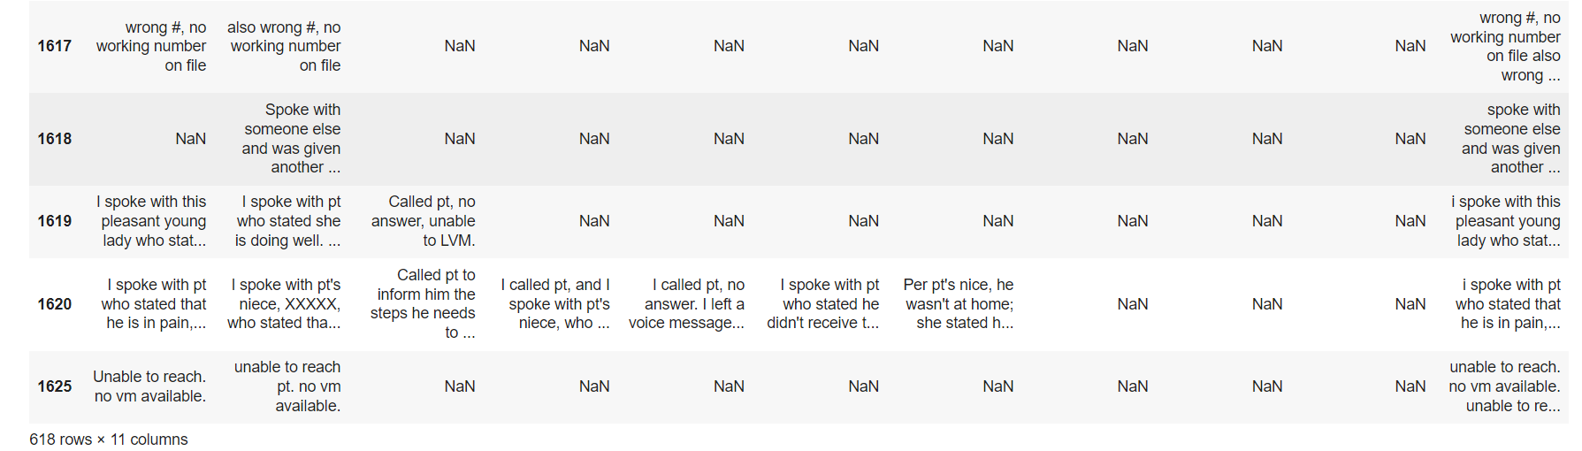
EDA
Dropped records with combined_notes field as null value.
Cleaned data has 618 records

Slide 19
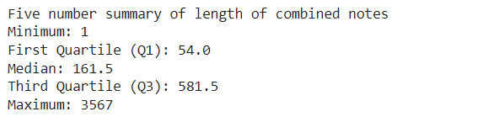
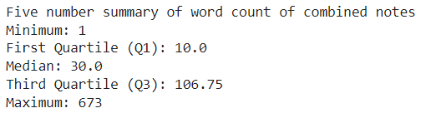
EDA
Five number summary on notes length.
Five number summary on word count.

Slide 20
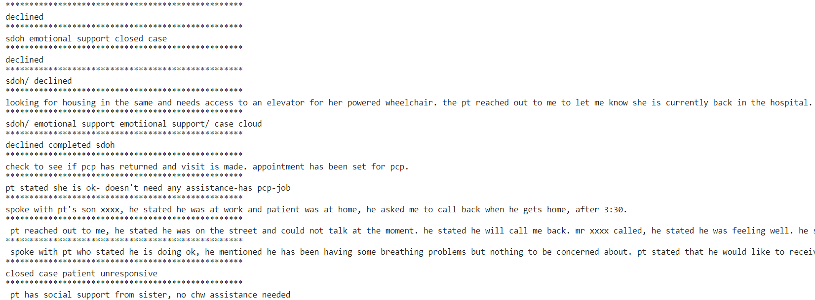
Data Cleaning
Cleaned notes look as follows after removing unwanted characters

Slide 21
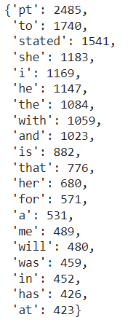
Frequent Words
Following are the top 20 frequent words in the notes.
Abbreviations are replaced by the actual words in the next step.

Slide 22
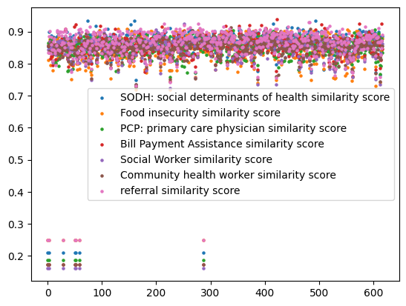
Similarity Score distribution - BioBERT (Topics)
Similarity score distribution of BioBERT is as follows when used the topics to find most relevant sentence from the context provided.

Slide 23
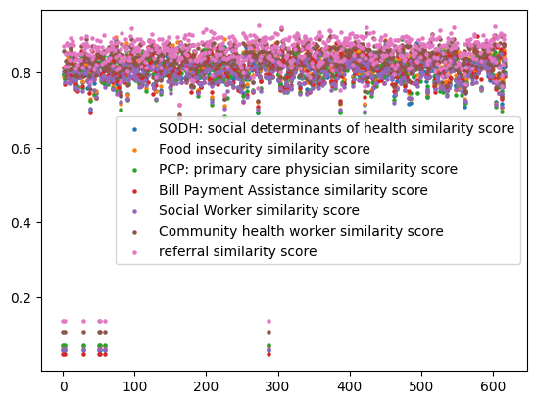
Similarity Score distribution - BioBERT (Statements)
Similarity score distribution of BioBERT is as follows when used the statements that explain the topics (contain more words relevant to the topic) to find most relevant sentence from the context provided.

Slide 24
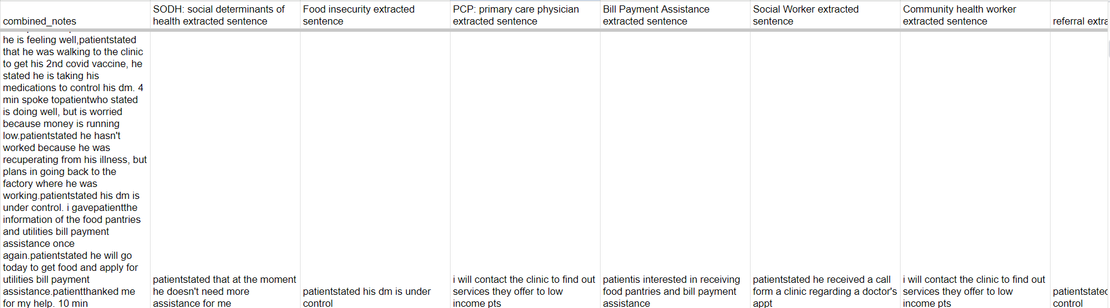
BioBERT (Topics)
Sample screenshot of a record extracted

Slide 25
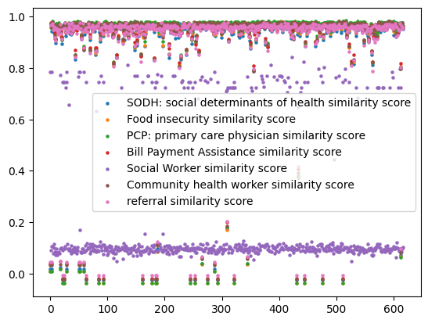
Similarity Score distribution - BERT Large (Topics)
Similarity score distribution of BERT Large is as follows when used the topics to find most relevant sentence from the context provided.

Slide 26
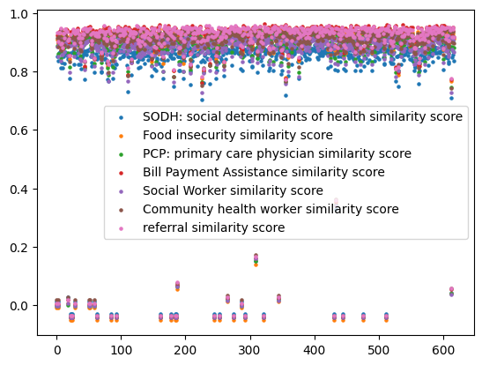
Similarity Score distribution - BERT Large (Statements)
Similarity score distribution of BERT Large is as follows when used the statements that explain the topics (contain more words relevant to the topic) to find most relevant sentence from the context provided.

Slide 27
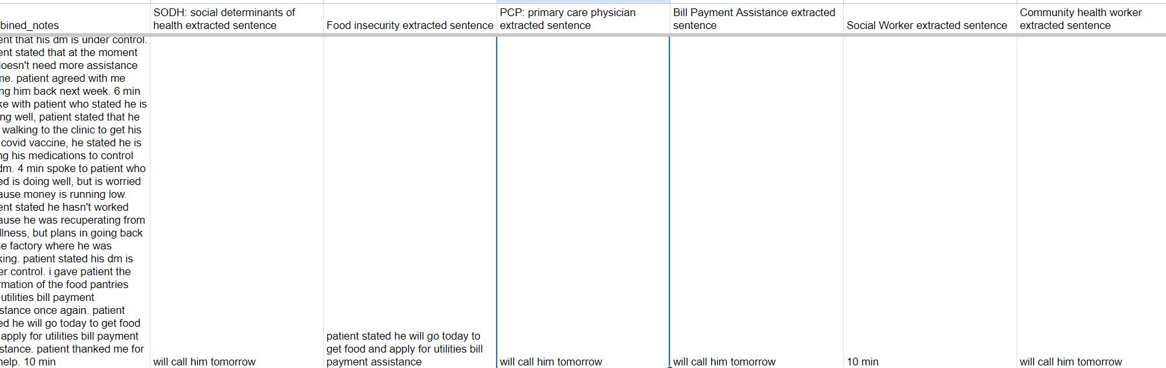
BERT Large (Topics)
Sample screenshot of a record extracted

Slide 28
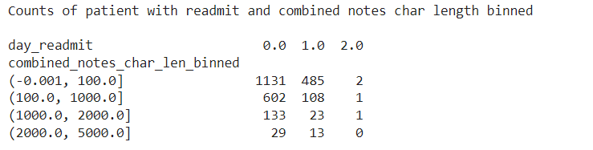
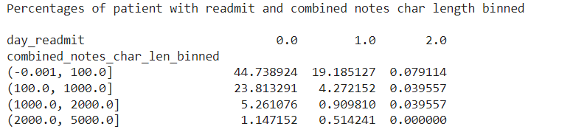
Readmitted vs Combined Notes
Counts of readmitted patients along with binned char length
Percentages of readmitted patients along with binned char length

Slide 29
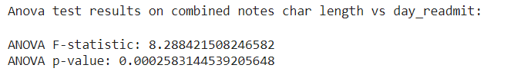
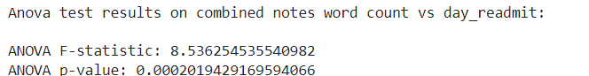
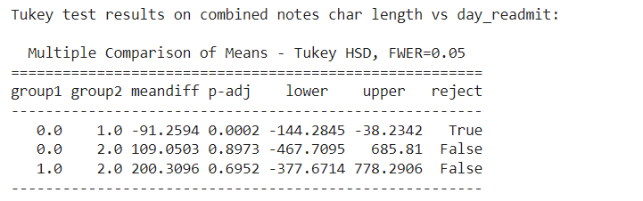
Statistical Tests
ANOVA to show the significant differences in the means of patients readmitted or not
Tukey Test to show the significant differences in the means of patients readmitted or not

Slide 30
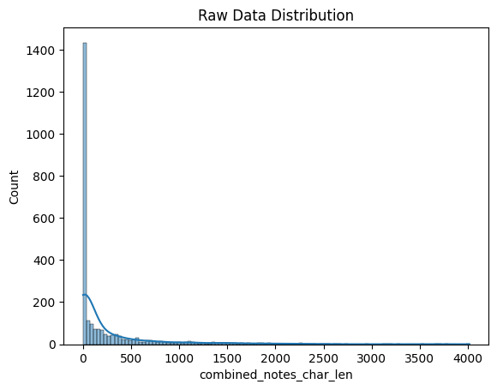
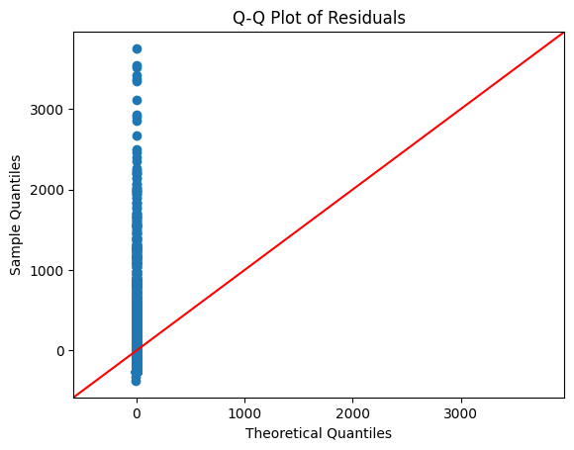
Visualizations (Distributions)
Data Distribution of combined notes and QQ plot of residuals between actual values and means

Slide 31
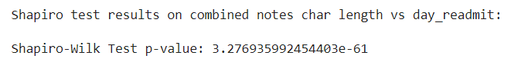
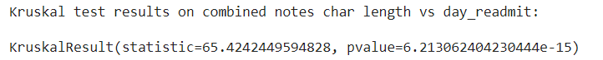
Statistical Tests (Cont)
Shapiro test to check the normality of the data
Kruskal, a non-parametric test to compare the medians of three or more groups.

Slide 32
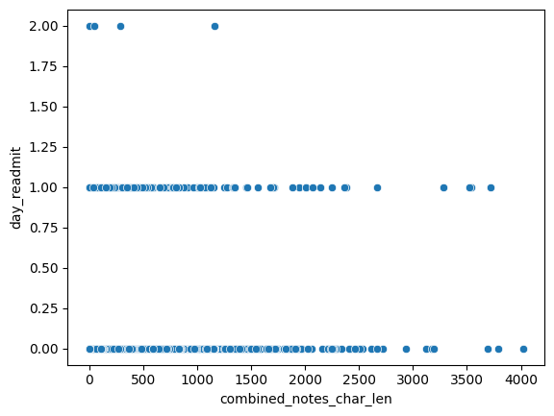
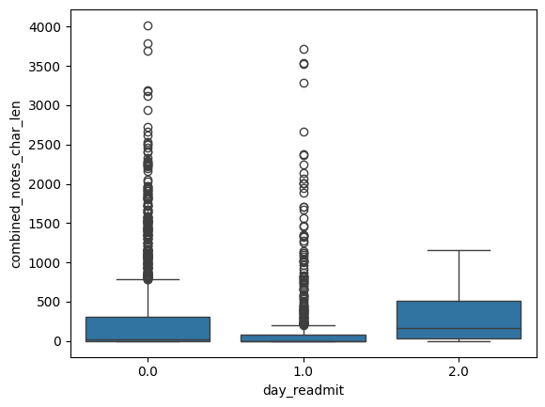
Visualizations (Cont)
Data Distribution of combined notes vs day_readmit (Readmission)

Slide 33
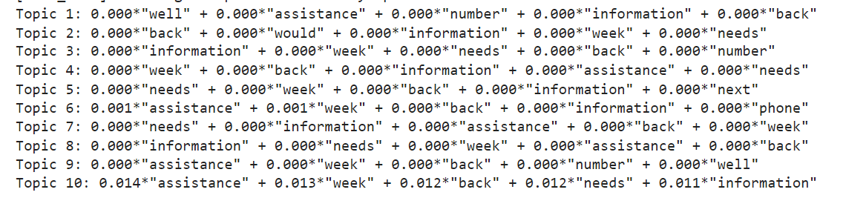
Topic Modeling
Avoided most common words like pt, stated, called from the context

Slide 34
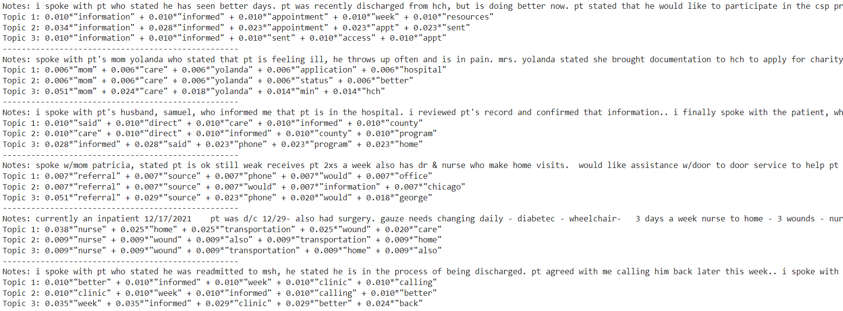
Topic Modeling - Readmitted pts with longer notes
Topic modeling on individual patients with readmit as 1 and combined notes character length greater than 2000.

Slide 35
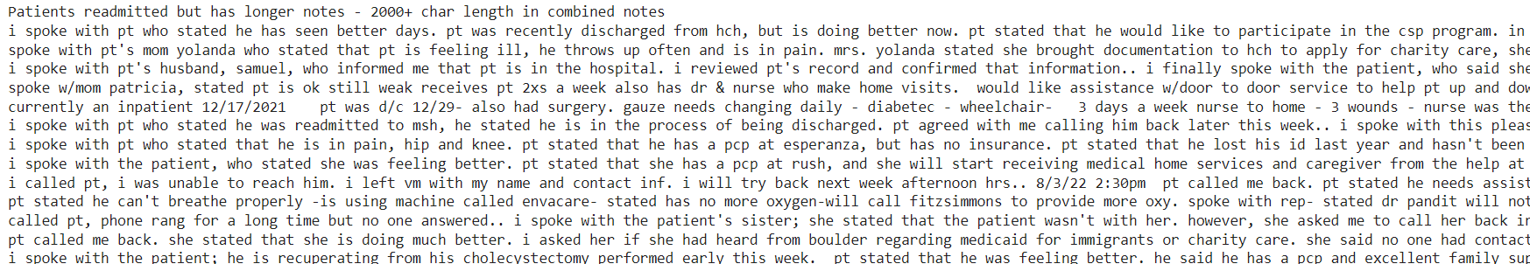
Readmitted pts with longer notes
Patients with readmit as 1 and combined notes character length greater than 2000.

Slide 36
NEXT STEPS
Topic Modeling on combined notes of different groups of patients to understand differences in the topics discussed.
Generative models to get more meaningful topics from the content.
Including each topic as a feature based on whether it is discussed or not if it is discussed then it is positive or negative.

Slide 37
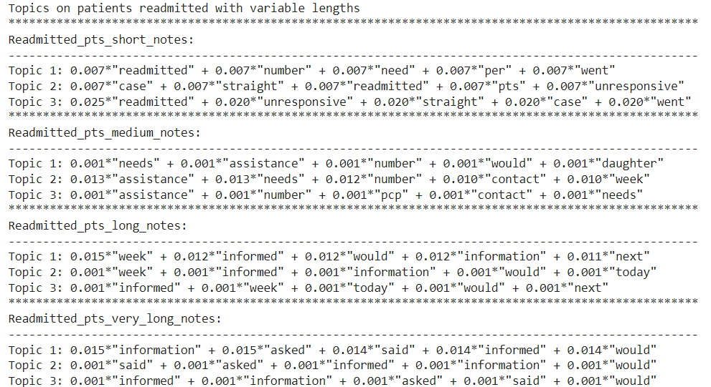
Readmitted pts concatenated notes variable lengths- LDA
Notes from readmitted patients of each group is concatenated.
Each group is given as separate input for topic modeling.

Slide 38
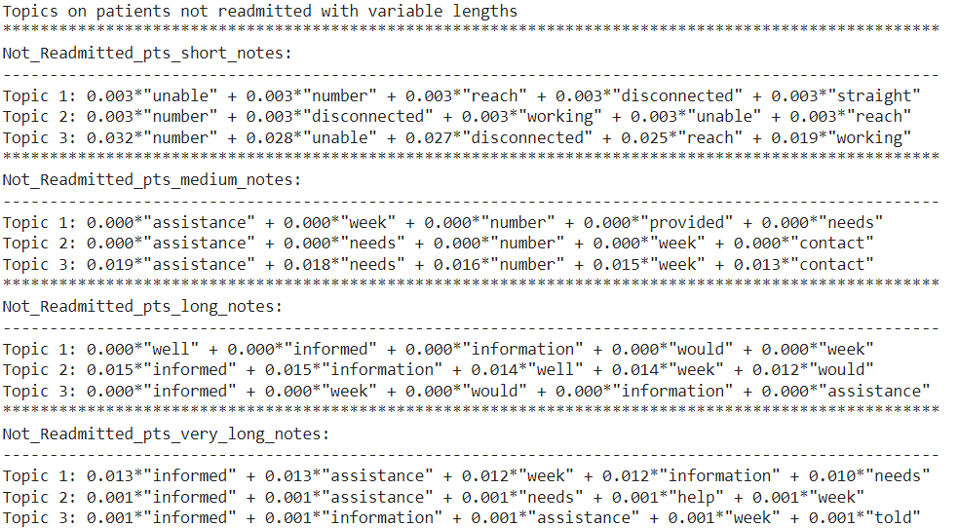
Not Readmitted pts concatenated notes variable lengths- LDA
Notes from not readmitted patients of each group is concatenated.
Each group is given as separate input for topic modeling.

Slide 39
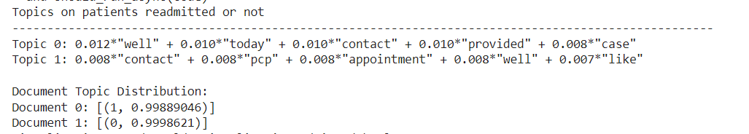
Readmitted & Not pts concatenated notes - LDA
Notes from patients of each group is concatenated.
Patients readmitted & not readmitted are analyzed.
Doc 0 represents readmitted, and Doc 1 represents not readmitted.

Slide 40
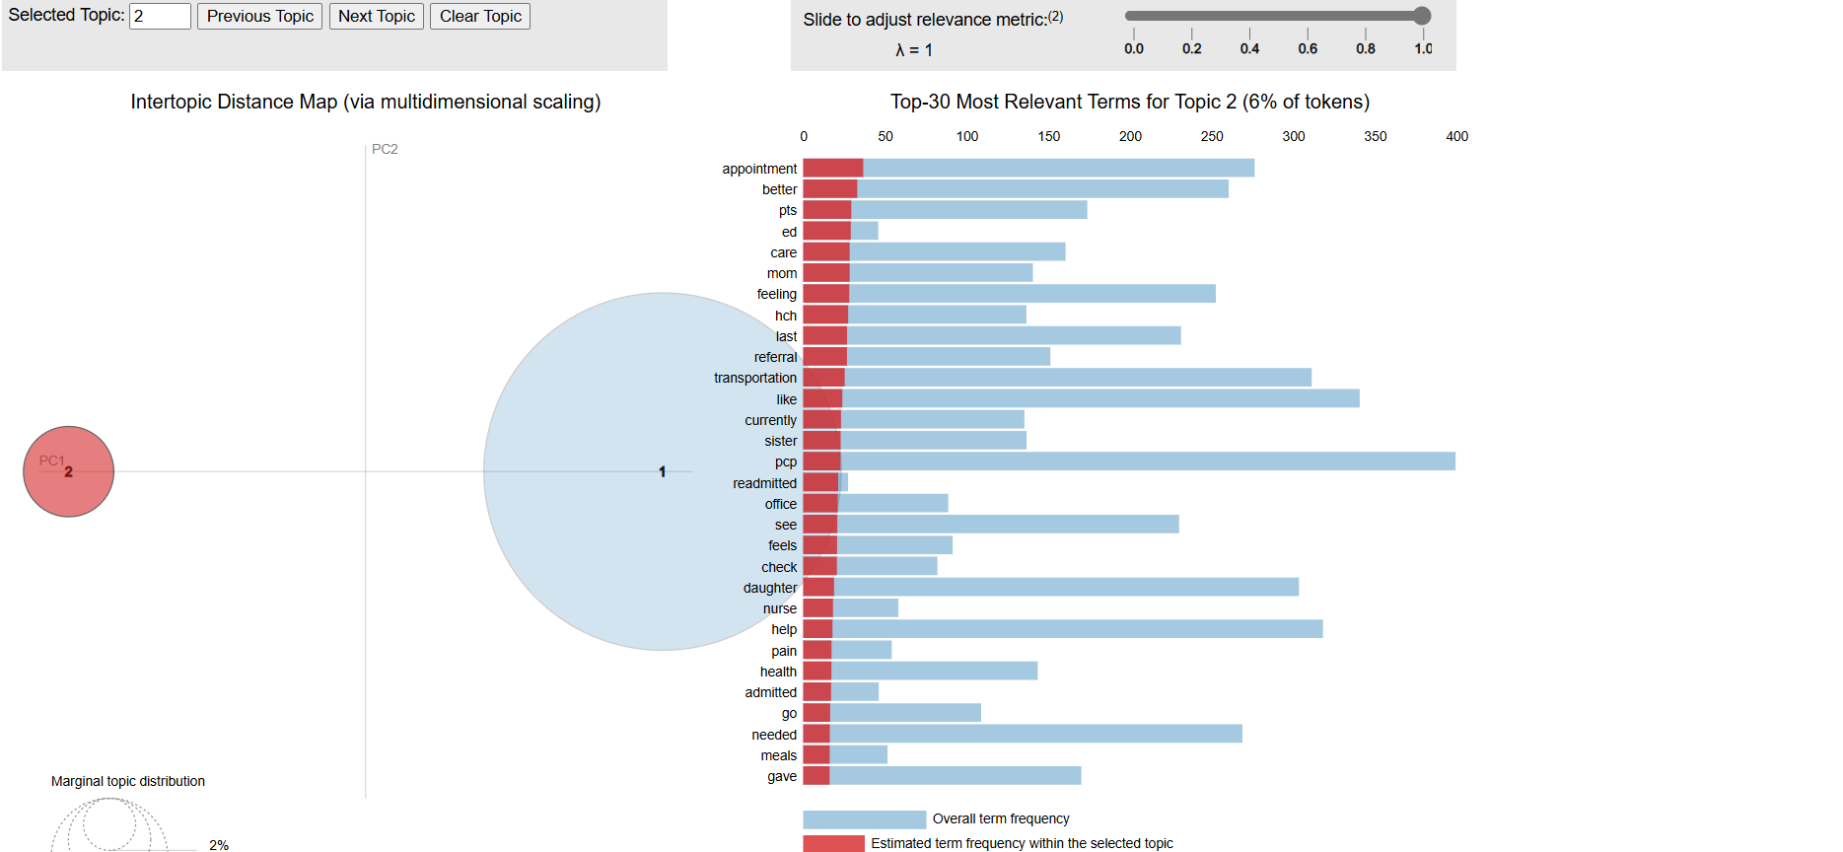
Readmitted vs Not pts concatenated notes – LDA Vis
Visualization of readmitted and not readmitted patient topics.

Slide 41
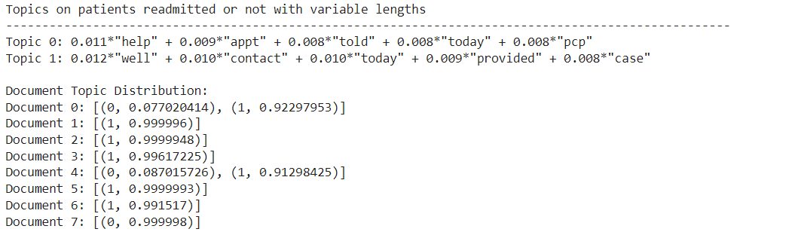
Readmitted vs Not pts concatenated notes - LDA
Notes from patients of each group is concatenated.
Patients readmitted & not readmitted with variable lengths are analyzed.
Document 0-3 represents patients readmitted and 4-7 represents patients not readmitted
Each doc represents one group based on length as short (<100 char len), medium(100-1000), long(1000-2000) and very long(2000-5000) notes in order.

Slide 42
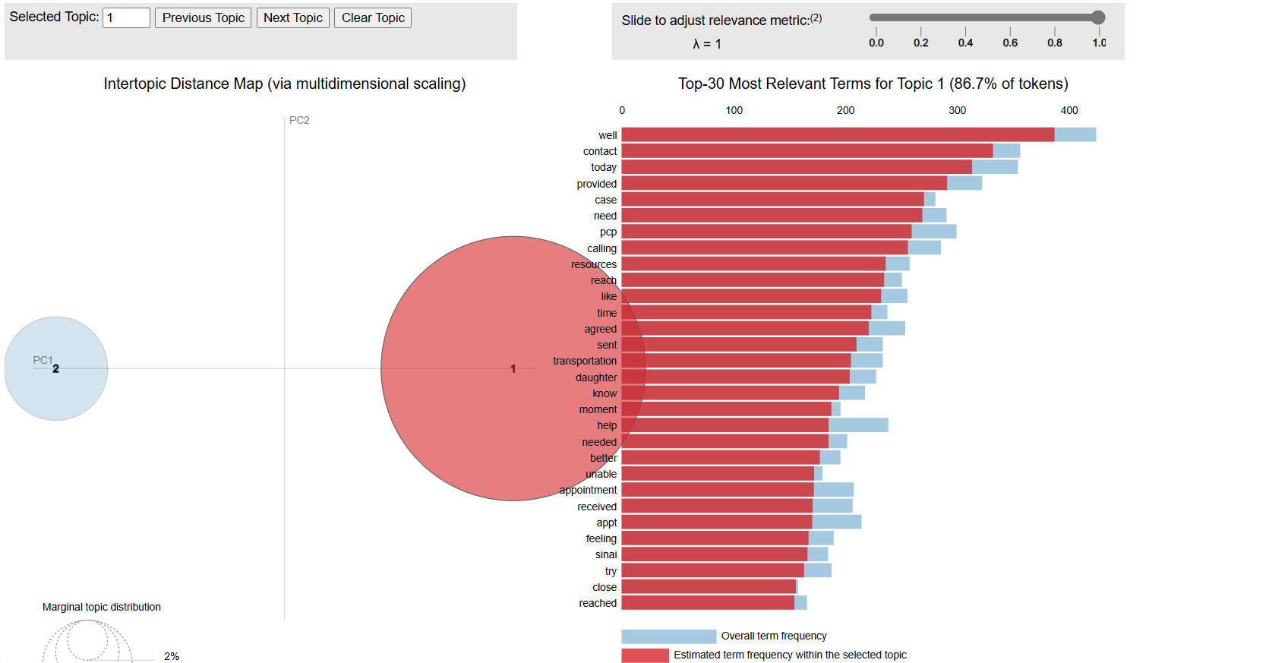
Readmitted vs Not pts concatenated notes - LDA
Visualization of Patients readmitted & not readmitted related topics with various lengths considered.

Slide 43
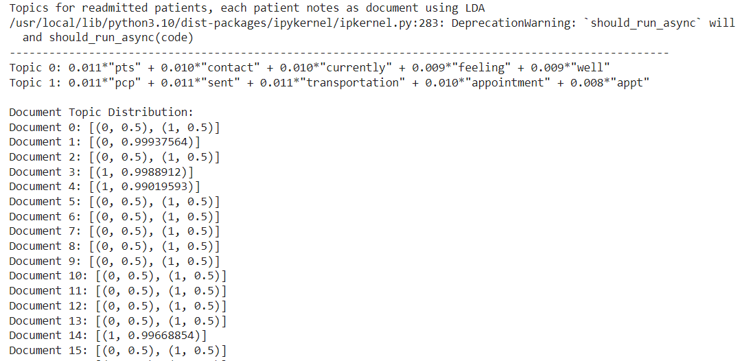
Readmitted pts individual notes - LDA
Notes from readmitted patients is considered.
Notes of each patient is considered as a document.
List of notes of all readmitted patients is given as a list of docs for LDA model

Slide 44
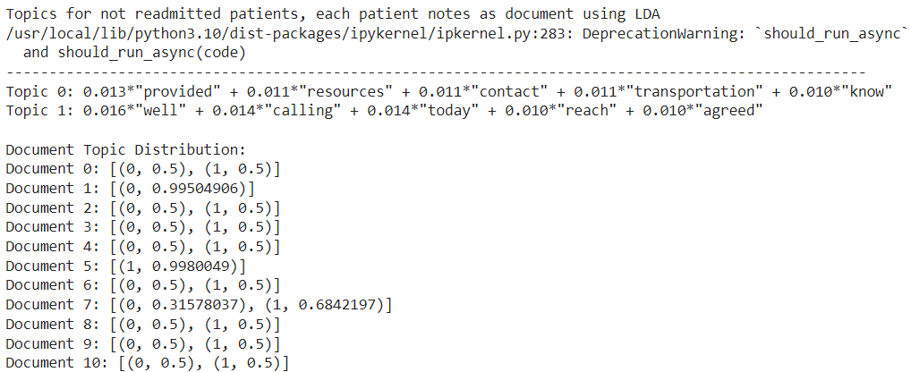
Not Readmitted pts individual notes - LDA
Notes from not readmitted patients is considered.
Notes of each patient is considered as a document.
List of notes of all not readmitted patients is given as a list of docs for LDA model

Slide 45
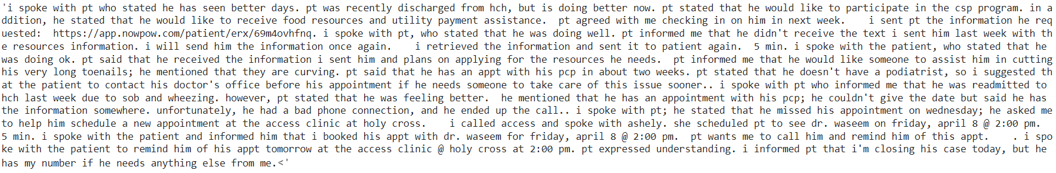
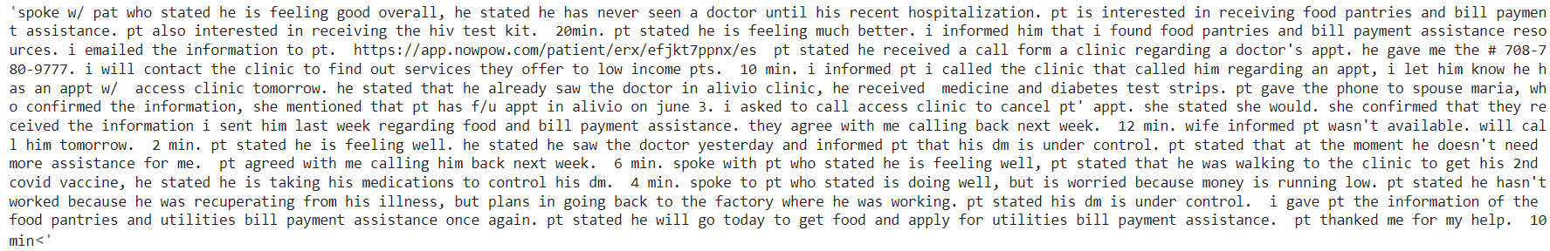
Readmitted and Not readmitted very long sample Notes
Readmitted very long sample Notes
Not readmitted very long sample Notes

Slide 46
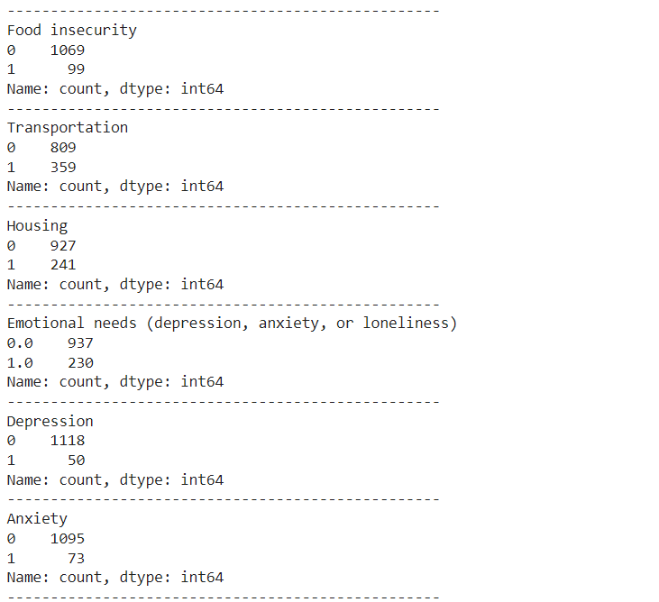
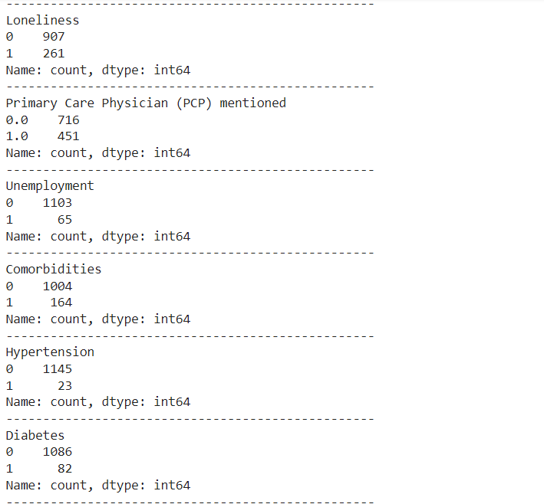
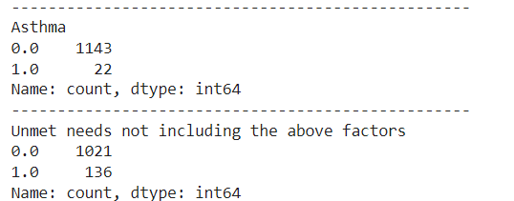
Generative model to find the presence of topic
Generative model to find whether the topic is discussed in the notes or not.
0 – represents absence of topic, 1- represents presence of topic

Slide 47
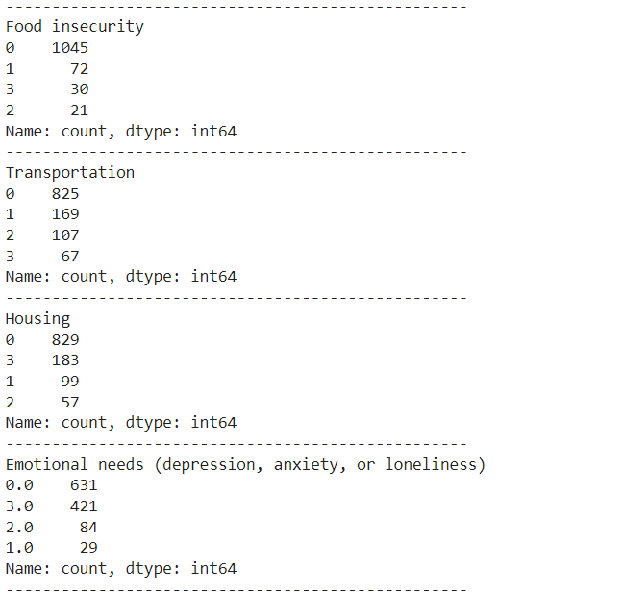
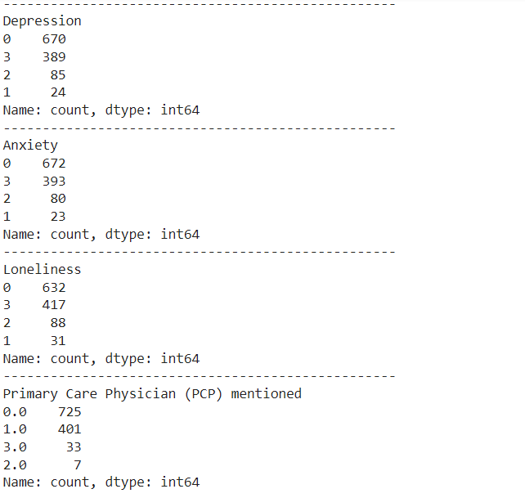
Generative model to find the presence & sentiment
Generative model to find whether the topic is discussed in the notes or not if discussed what is the sentiment of the topic.
0 – represents absence of topic, 1- represents positive, 2 – represents negative and 3 – represents neutral.

Slide 48
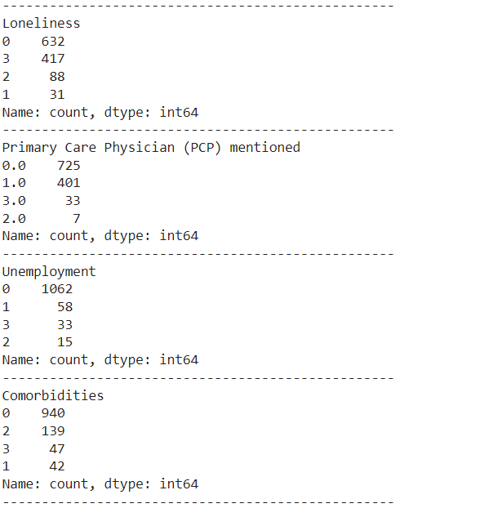
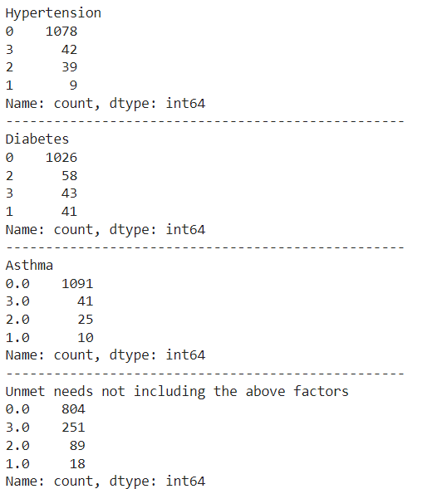
Generative model to find the presence & sentiment
Generative model to find whether the topic is discussed in the notes or not if discussed what is the sentiment of the topic.
0 – represents absence of topic, 1- represents positive, 2 – represents negative and 3 – represents neutral.

Slide 49
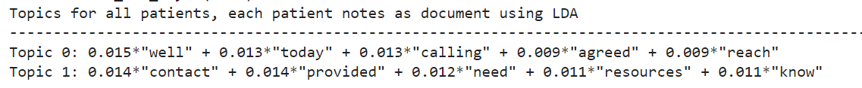
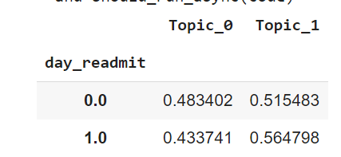
Topic modeling on all the patients with notes
Topic modeling is performed on all the patients with notes that has atleast 1 character.
Following are the topics generated along with mean of topic distributions in readmitted and not readmitted patients.

Slide 50
Notes
Some of the most frequent words like pt, stated, spoke, called are included as additional stop words.

Slide 51
Hyper Parameter Tuning
Testing Phi-3.5 model performance in terms of consistency with various hyper parameters like Temperature, Top-P, Top-K and do_sample.
Evaluating differences in performance of Phi-3.5 model at different levels of creativity.

Slide 52
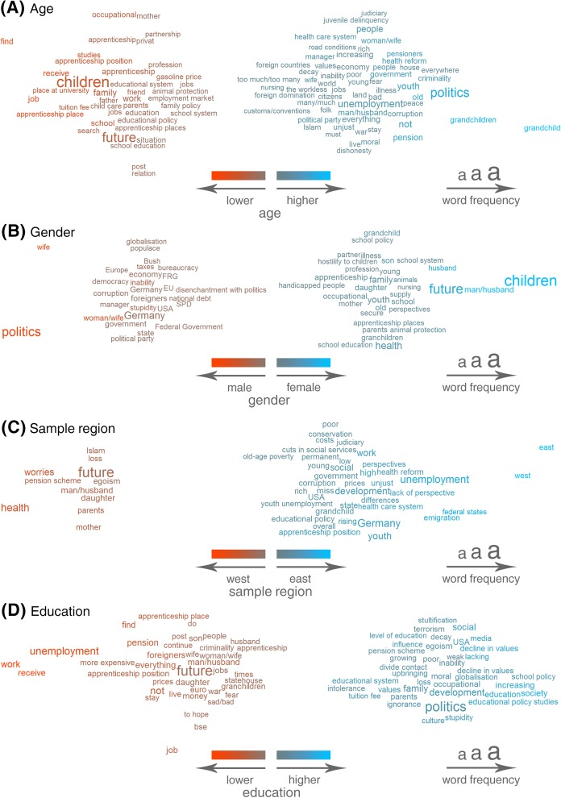
Literature
Integrating text data to existing quantitative variables to improve the prediction performance. https://pmc.ncbi.nlm.nih.gov/articles/PMC5536367/ Used Topic Modeling to get the probabilities of each record representing a topic and rounded them to represent presence or absence of a topic in the record. (Topic Threshold = 0.3)

Slide 53
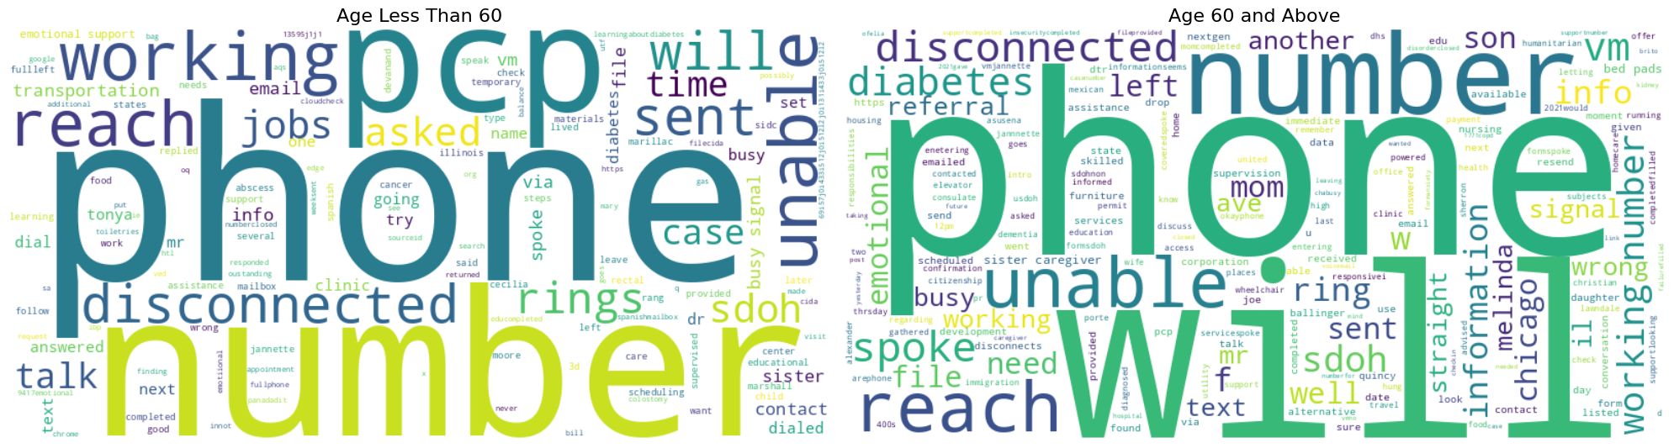
Other Independent Variables vs Notes – Word Cloud

Slide 54
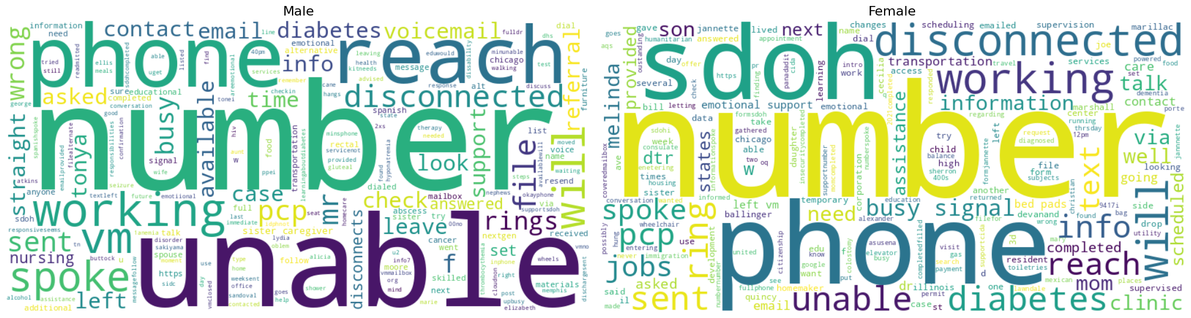
Other Independent Variables vs Notes – Word Cloud

Slide 55
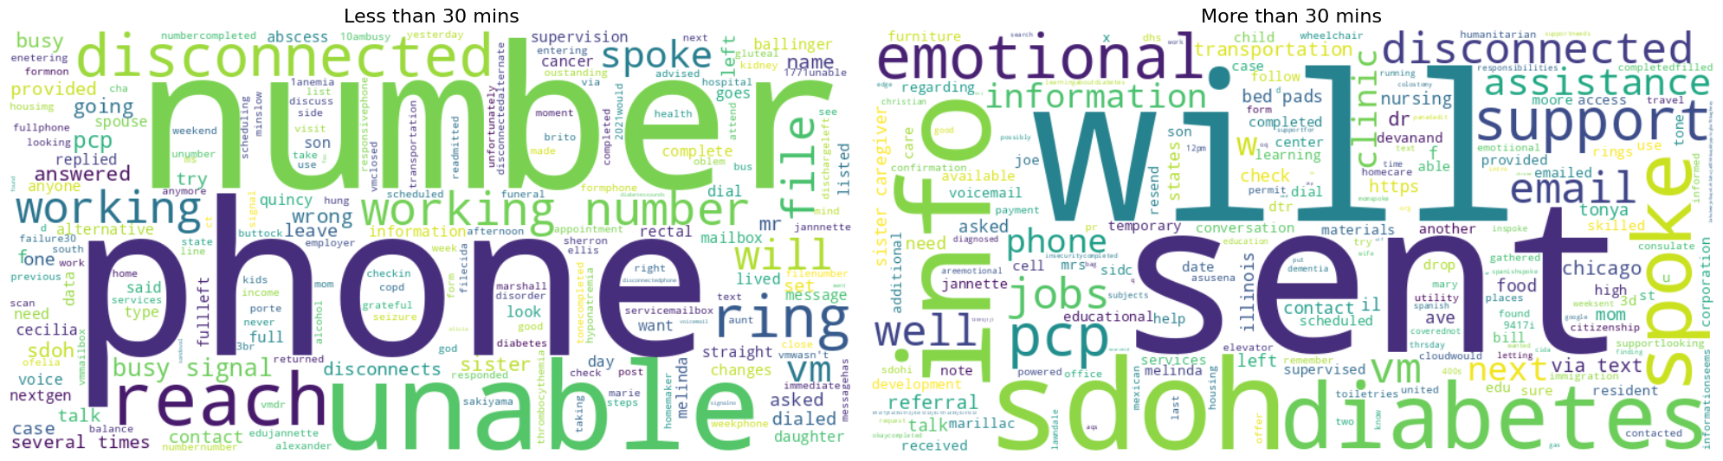
Other Independent Variables vs Notes – Word Cloud

Slide 56

Other Independent Variables vs Notes – Word Cloud

Slide 57

Other Independent Variables vs Notes – Word Cloud

Slide 58
Literature
https://pmc.ncbi.nlm.nih.gov/articles/PMC7861220/pdf/frai-03-00016.pdf Created a list of topics manually and assign the text to topics by finding the key words or calculating Levenshtein distance if misspelled.

Slide 59
Matrix Generation
Generated a matrix on the entire data using Phi-3.5 and then encoded each categorical variable (topic).
0, 1, 2 & 3 are the values assigned for each topic.
0 represents absence of discussion
1 represents positive discussion
2 represents negative discussion
3 represents neutral discussion
3 and 0 are combined to replicate the existing format.
Created one hot encoded matrix using dummies function from Pandas.

Slide 60
Next Steps – 11/11/2024
Pre-Processing Text
Filter the notes based on the actual content vs unwanted information(No Response) at individual notes level using Generative model.
Topic Modeling
Try Biterm Topic Model (BTM) instead of LDA which works better in short texts
Refine the Topic modeling result to get more meaningful topics.

Slide 61
Bi Term Topic Model
Can be implemented via 2 packages – bitermplus & biterm

Slide 62

Bitermplus topics
For 20 iterations with 15 topics.
Increasing # of topics resulting into more relevant topics

Slide 63

Bitermplus topics
Words in the topics has very little probability.

Slide 64

Bitermplus – optimal # of topics
Optimal # of topics considered to between 10 to 15 from the following Elbow plot.

Slide 65

Bitermplus – optimal # of iterations
Optimal # of iterations are considered as 250 from the following Elbow plot.

Slide 66

Bitermplus – cross tab
Cross tab of labels assigned by topic model and patient readmitted or not.

Slide 67

Bitermplus – Topics
Topics generated by Bitermplus

Slide 68

Bitermplus – Word probabilities
Word probs for all the topics

Slide 69

Bitermplus – Topic Probs
Topics probabilities for all the documents.

Slide 70

Random forest classifier
Imbalanced data results in poor performance with readmitted patients

Slide 71
Next steps – 12/16/2024
Follow up on scripts and Neural Networks paper
Read additional papers suggested by Ankita
Improve the classifier – Imbalance data handling, Missing values handling
Use the probabilities of topics instead of most probable topic

Slide 72
Classification model performance comparison
Correlation between topic probabilities for each of the topic and patient readmission.
No correlation was found in the topic probabilities of documents w.r.t Patient readmission

Slide 73

Bitermplus – Topic Probs correlation matrix
Correlation between topic probabilities for each of the topic and patient readmission.
No correlation was found in the topic probabilities of documents w.r.t Patient readmission

Slide 74


Classification model performance comparison
Classification model performance before and after including topic probabilities.
Performance slightly decreased after including the topic probabilities.

Slide 75

Classification model performance – Other team
Classification model performance for the entire dataset after rolling up by dropping repeated records of patients with multiple visits.

Slide 76
Next steps – 12/30/24
Train a basic BERT classifier using pre-trained BERT base uncased model on notes and day_readmit – In progress
Generate embeddings from the notes using BERT and its variants, implement feature reduction techniques, feature importance/ selection techniques, integrate with tabular features to train a classifier.
Explore on existing pre-trained multimodals on text data for classification.

Slide 77
Data Inconsistencies
Records with same record_id are considered as same patient info but those records has different age values, rage, gender, notes and discrepancies in other fields too.
record_id is the field used to roll up the data of repeated patients.
record_id is the field that indicates the visit number of the same patient.
If the patient has different records for different visits. Why does each record have up to 10 notes.

Slide 78
Leveraging Embeddings to make classification
Paper on Enriching Tabular Data with Contextual LLM Embeddings (https://arxiv.org/pdf/2411.01645v1)
Different LLMs like GPT-2 and RoBERTA are used to generate embeddings.
Combination of embeddings from different models and tabular data is evaluated to predict the best combination on various publicly available datasets.
Privacy-Preserving Potential.
Increased performance compared to traditional ensemble model performance on tabular data when embeddings are integrated with tabular data.

Slide 79
Revisiting Multimodal Transformers for Tabular Data with Text Fields
Paper on Tabular-Text Transformer (https://aclanthology.org/2024.findings-acl.87.pdf)
TTT consistently outperforms other multimodal approaches in classification tasks, especially for datasets with smaller sample sizes or complex feature interactions.
The distance-to-quantile embedding scheme improves the handling of numerical features
Uncertainty quantification methods effectively identify predictions requiring expert review, enhancing trustworthiness in high-stakes applications.

Slide 80
Analysis Combinations
All Patients | Demo | Demo + Tabular | Demo + Tabular + Notes
Patients with notes | Demo | Demo + Tabular | Demo + Tabular + Notes

Slide 81
Analysis Combinations - Performance

Slide 82

Performance comparison

Slide 83
Feature Importances
Files with feature importance on Resource notes , All the notes concatenated

Slide 84
Performance variation
Performance decreased with by including Bigrams and Trigrams
Cross validation AUC is lower than Test AUC

Slide 85
Feature Importances
Feature importances at model training stage

Slide 86
THANK YOU

